Slide 1
Charlton & Singleton
Groundwater 2024/25

Slide 2
Key Questions
Placement of the system generators and pumps – need to be moved into the fields and further away from residential properties
Contractor’s vehicles and trucks to be parked in the fields off road to save verges being destroyed and small country roads being blocked
Status of pipe-lining work. There was an expectation formed that this would be carried out this calendar year
Consistency of the contractors used and lack of internal communication between SW and the contractors they use to carry out the works

Slide 3
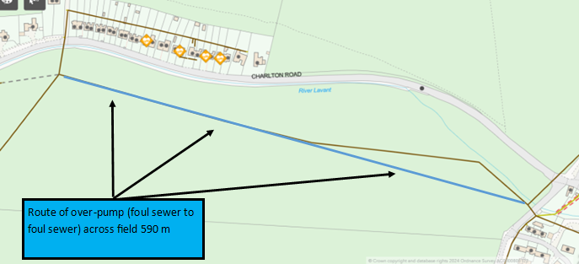
Charlton IRP Groundwater Management installation

Slide 4
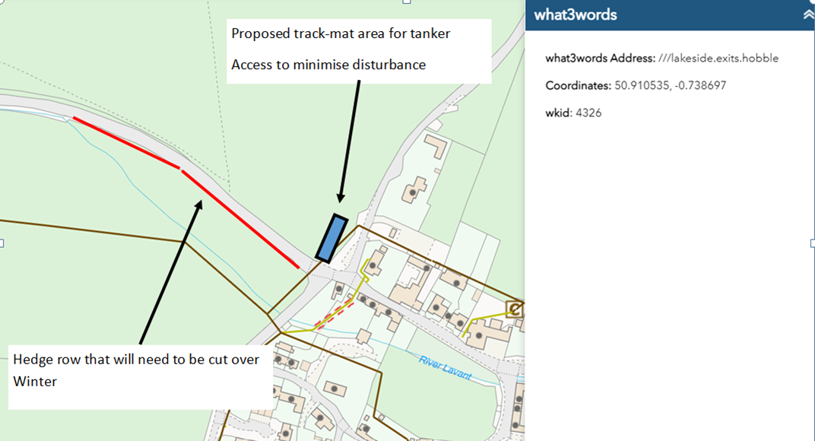
Proposals to get tankers off the road and away from residential properties

Slide 5
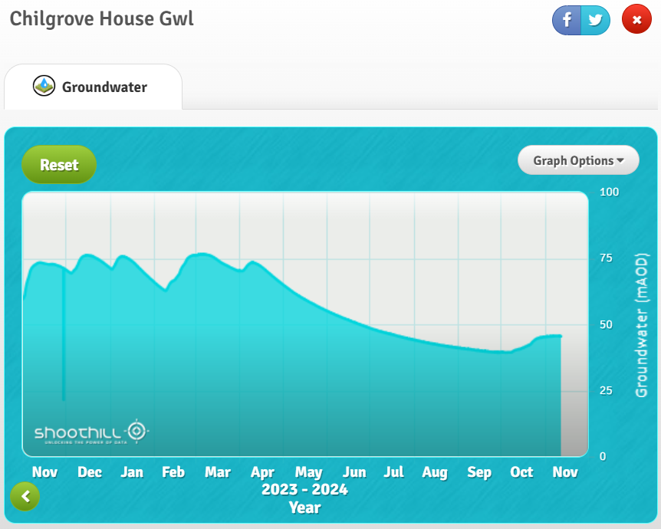
Current Borehole Level

Slide 6
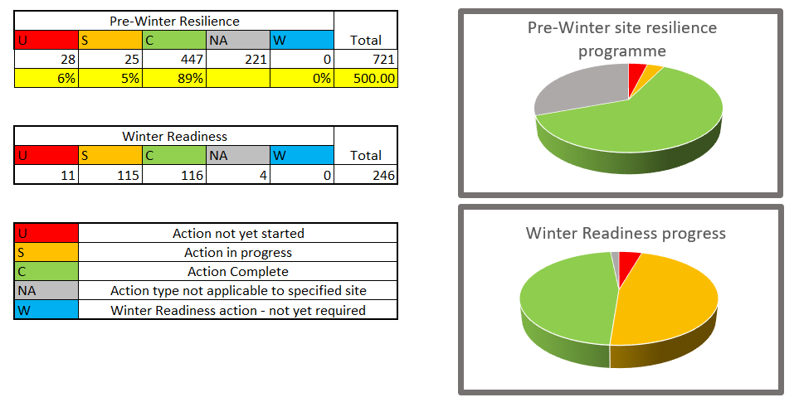
Preparation Progress

Slide 7
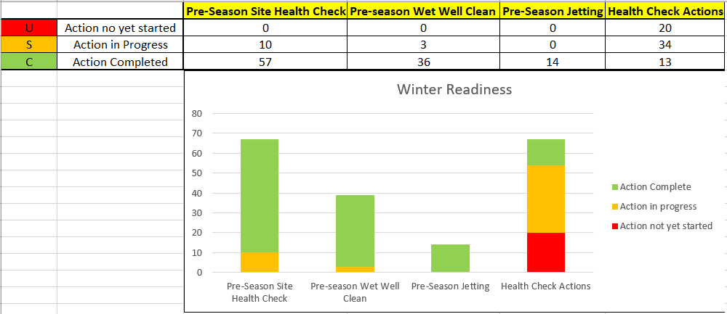
Winter Readiness

Slide 8
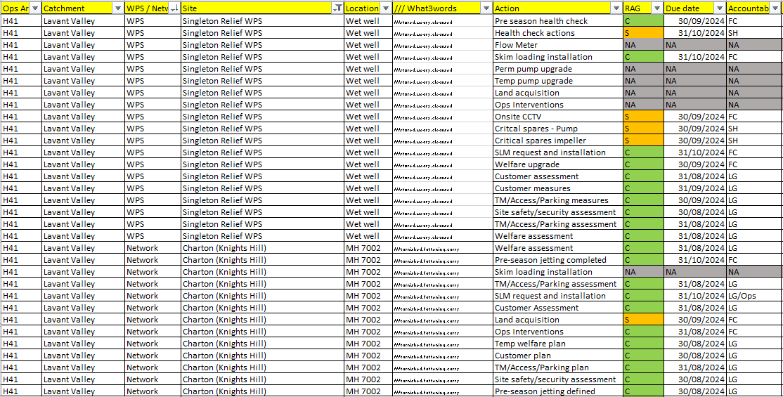
Charlton & Singleton specific actions

Slide 9
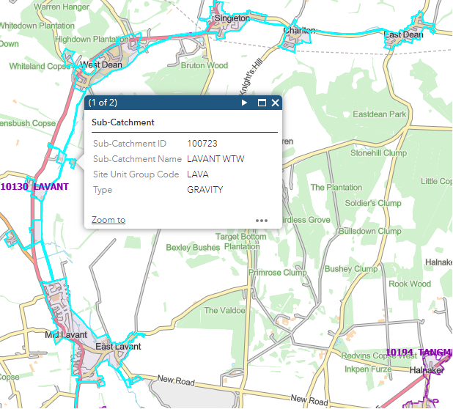
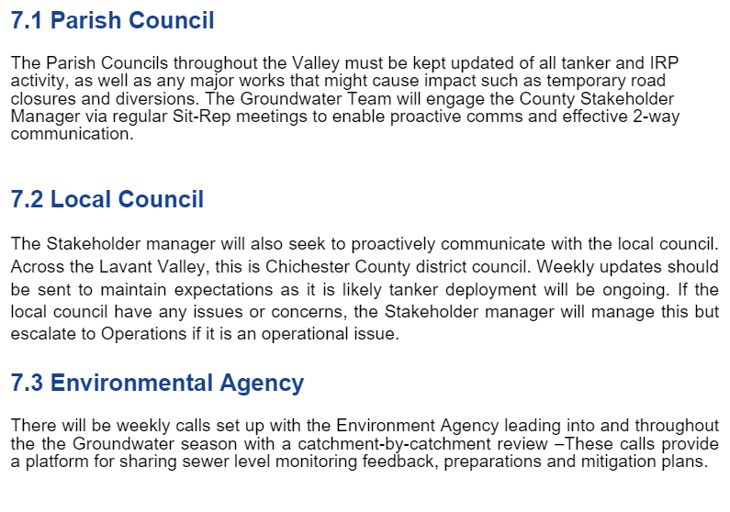
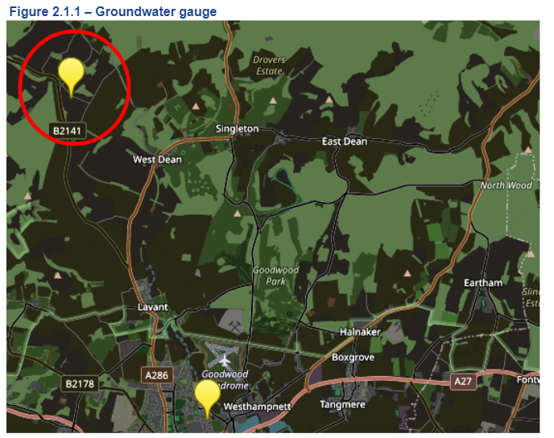
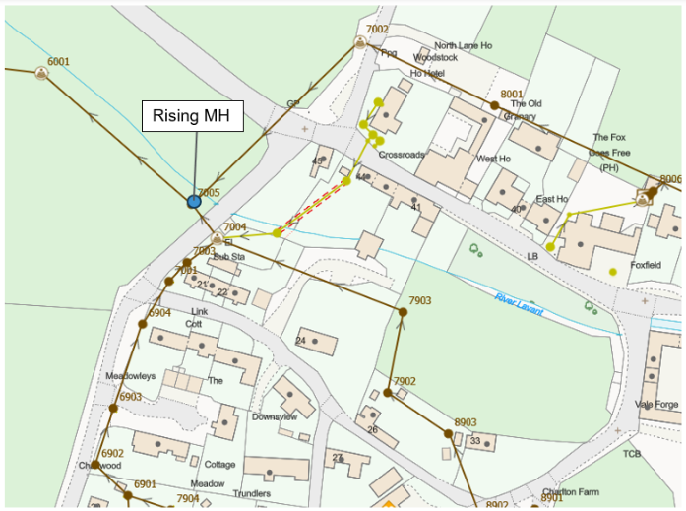
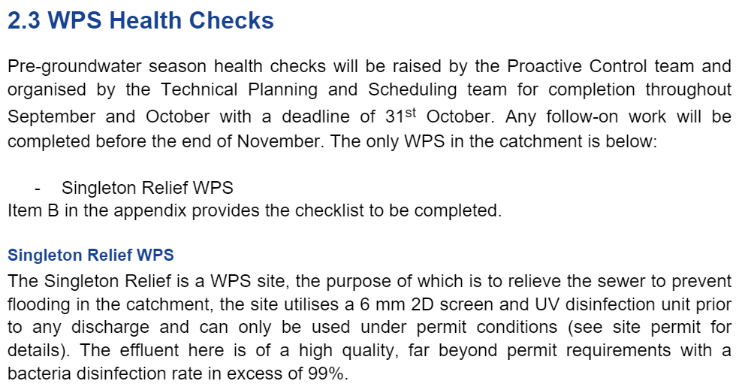
Playbook Content
Catchment Overview - Mapping
Catchment Overview - Information
Spill points and monitoring
Pre-season groundwater checks through TP&S

Slide 10
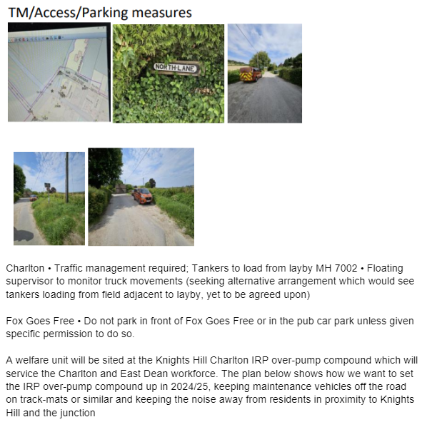
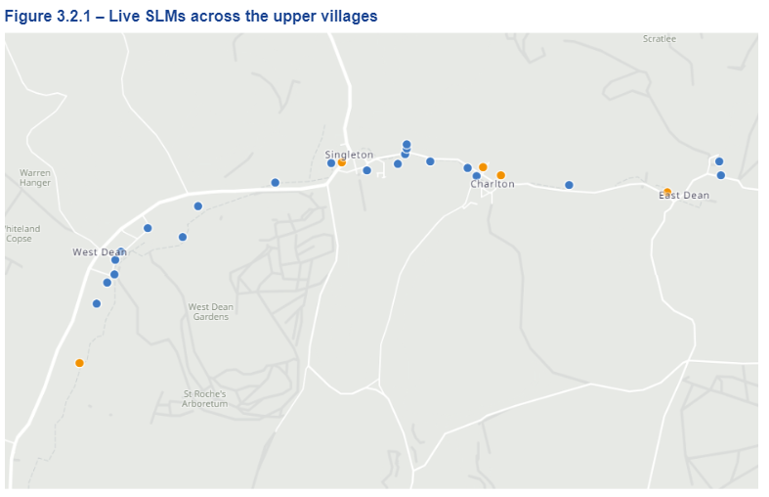
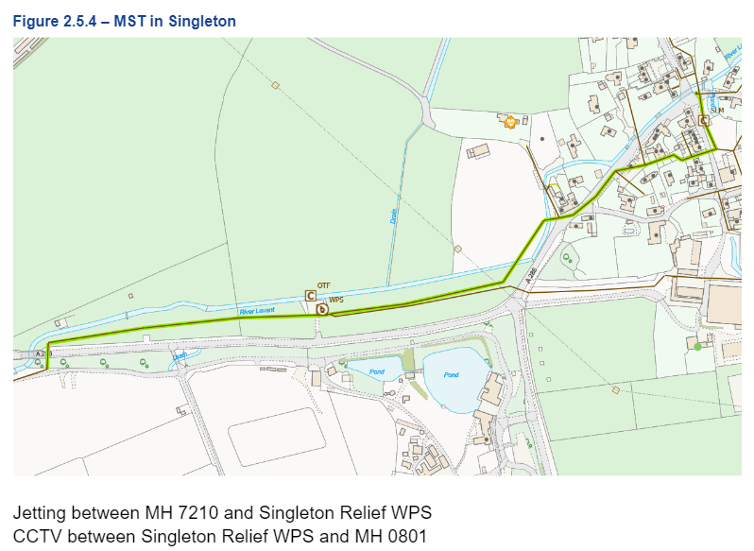
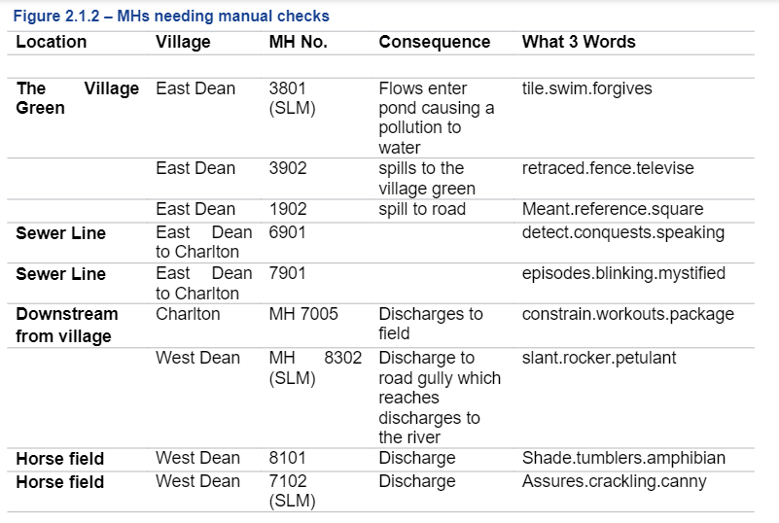
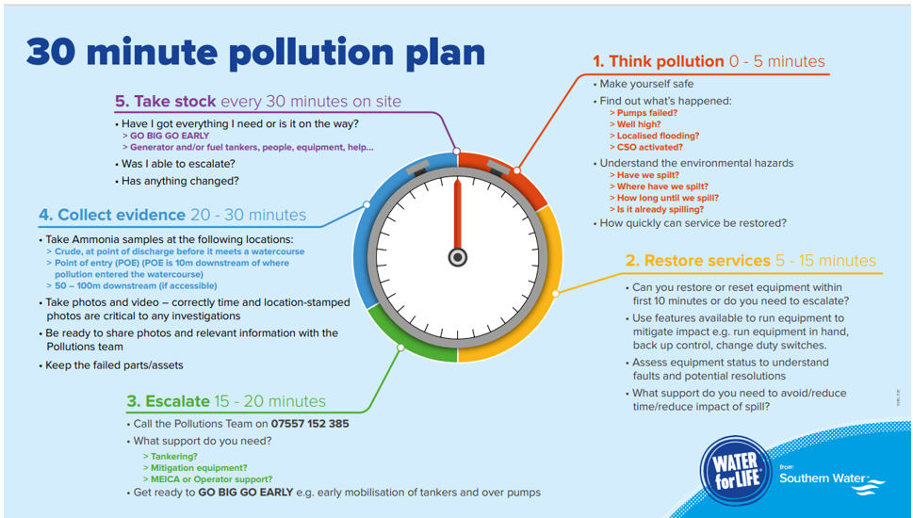
Playbook Content
Guidance on vehicles parking, positioning and safety
Details on Jetting MSTs in catchment
Prompt on pollution response expectations
Prioritised monitoring information

Slide 11
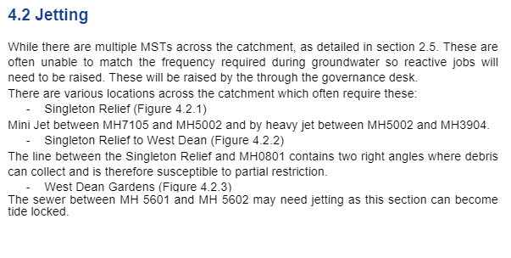
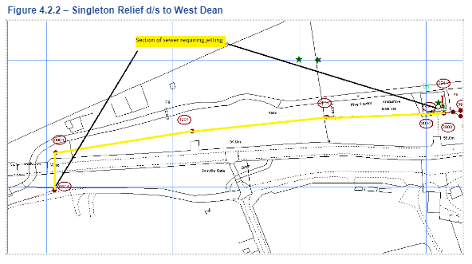
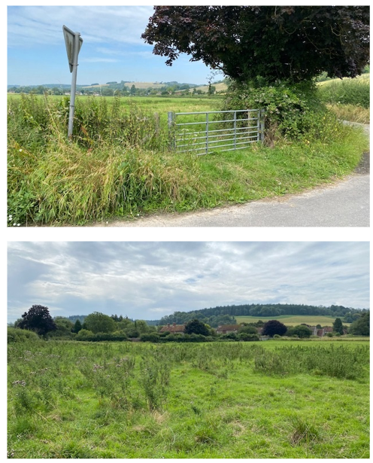
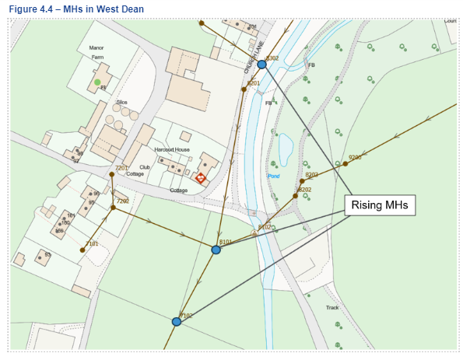
Playbook Content
Knights Hill, Charlton - Groundwater Management site location 2024/25

Slide 12
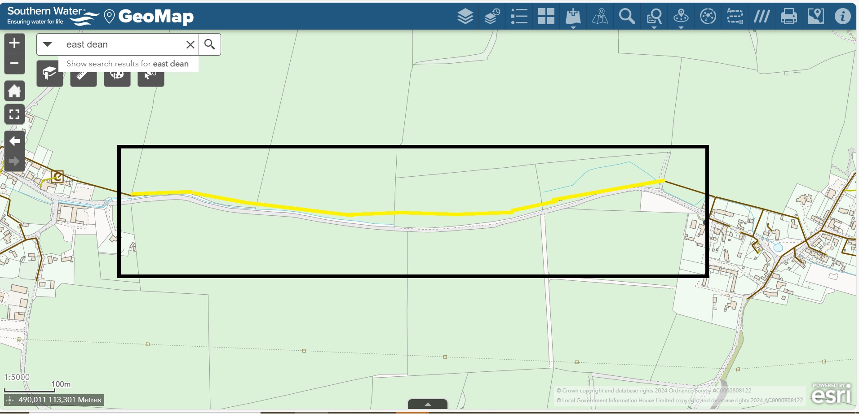
Current sewer sealing map East Dean to Charlton
Sewer sealing between East Dean and Charlton village started on 4/11/24 scheme due to be completed by end of Dec 24.
Approx 1050m of 150mm public sewer.

Slide 13
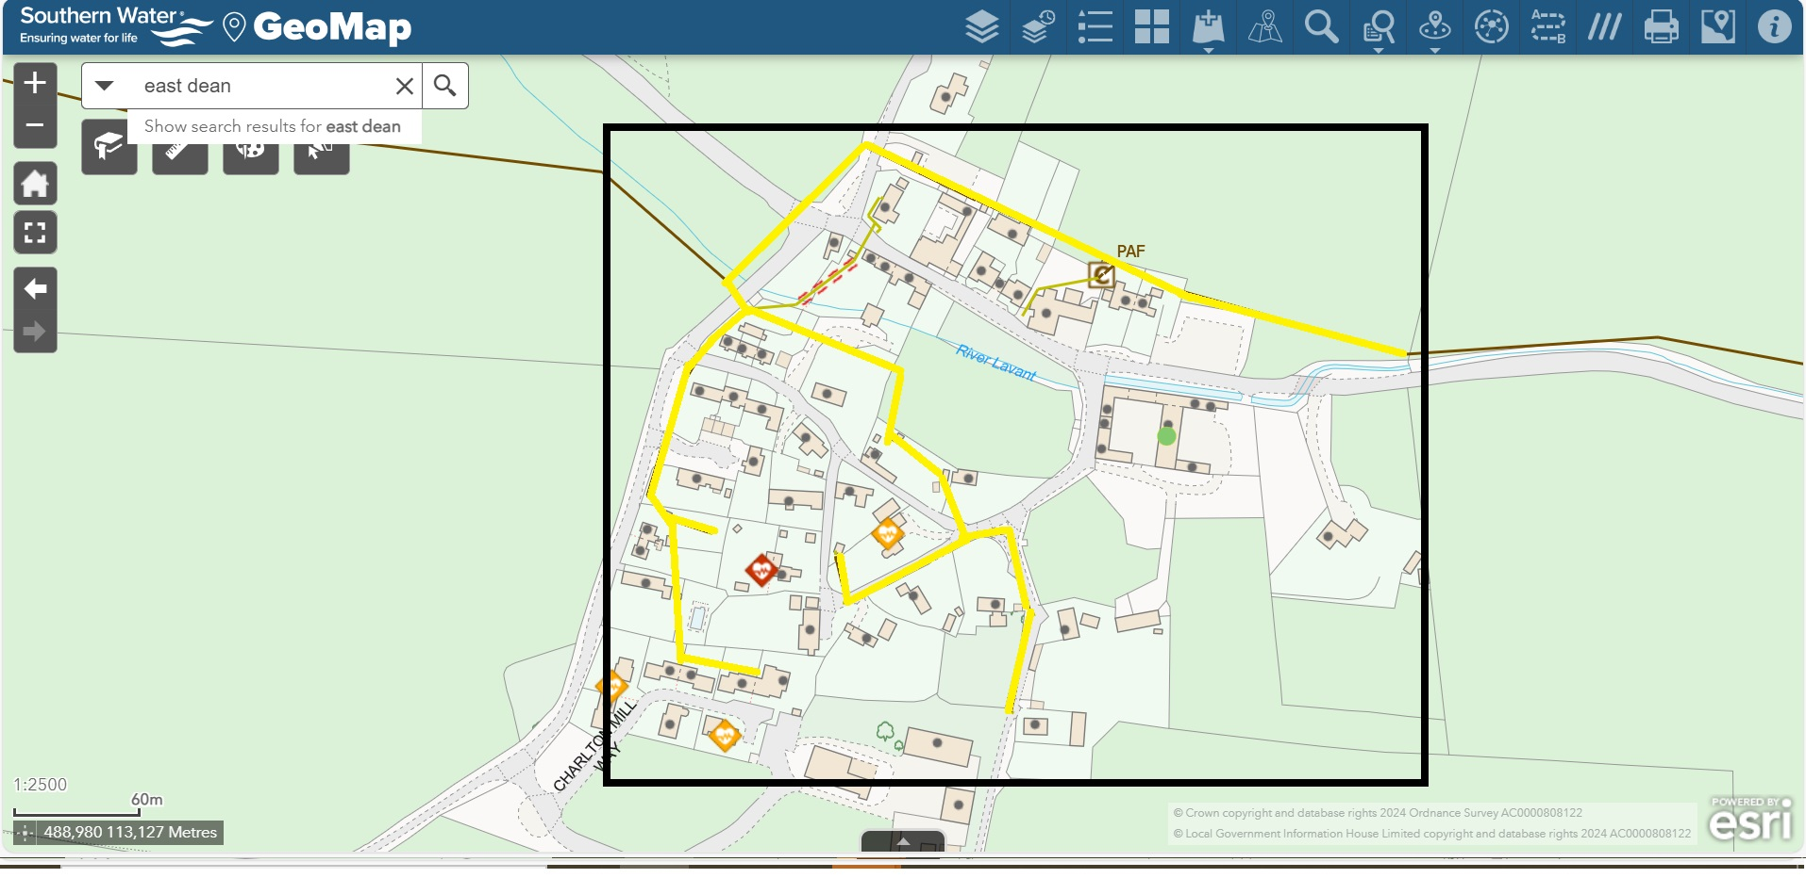
Charlton Village sewer sealing
Work has already started in the village of Charlton in the form of Manhole sealing.
Sewer sealing both public and private networks are on course to start on 18th Nov 24.
We anticipate to works to be completed by Jan 25.

